Slide 1

Project using QlikView basketball analysis
Dinesh Parthiban
dxp141330@utdallas.edu

Slide 2

Agenda
Findings
Insights
Challenges Faced
Recommendations

Slide 3

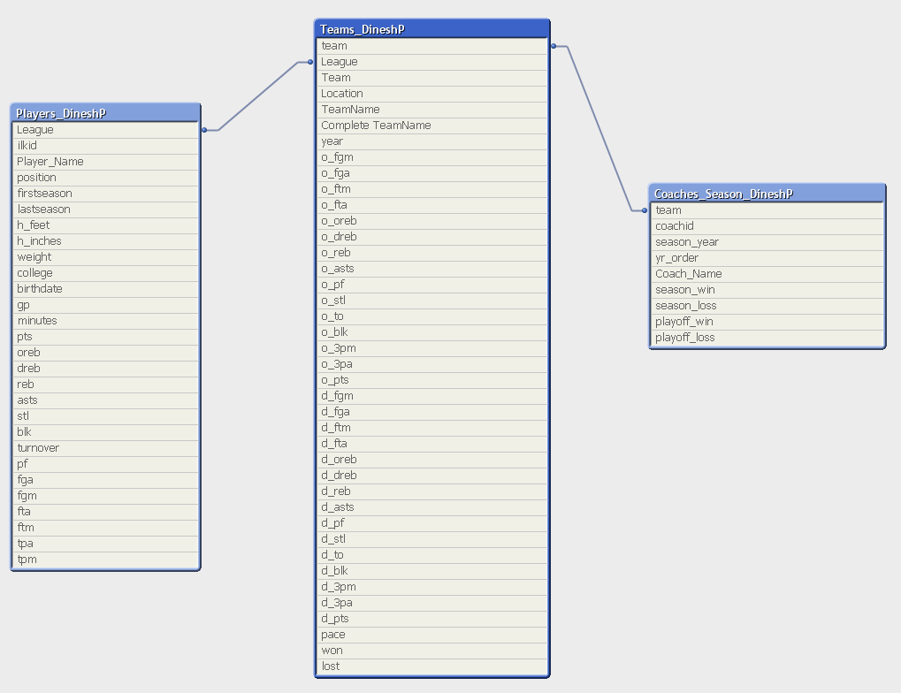
Findings
Data Observation
Data Structure – Dimensional Model.
Tables in Total - 5
Fact Table – 1
Dimensions – 2
Data - 1188 records in Fact table.

Slide 4
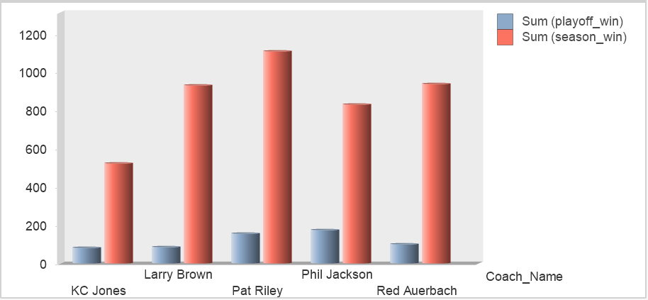
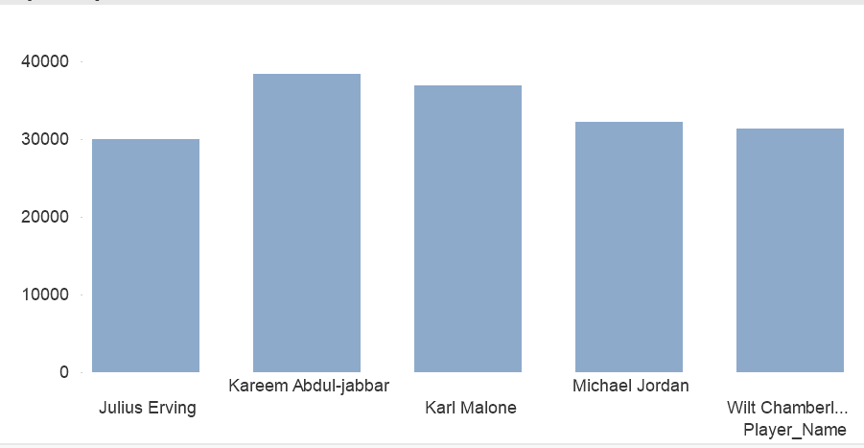
Insights
Contributing Factors
Won Season_Lost
Lost o_fgm
PlayOff_Win o_fga
Playoff_Lost o_ftm
Season_Win o_fta
Continued

Slide 5
Insights
Result of Analysis – BirdsEye Only
The highest winning team was CHI with 72 Wins and 10 Losses. CHI team was coached by 11 peoples throughout their 72 wins
PHI had the maximum number of loss (73 loss) with just 9 wins only. CHI was coached by 12 people during their 73 loss.
Conclusion
We just cant go by highest value but instead check the cumulative values which far exceeds the highest value.
Both records for highest winning and highest losing team as a part of NBA league
Number of coaches for ABA is less compared to NBA

Slide 6

Challenges
Working with zero information on dataset was the toughest task
Modelling the data was a challenge as the table were not linked
Deciding on the result was a challenge as there were numerous possibilities

Slide 7

Recommendations
Suggested Based on the cumulative values and not on the highest values.
Few college name were either none or empty. The data set is not clean to go ahead for visualization. This needs to be fixed
More regular expression and formula needs to be taught for deeper analysis

Slide 8
Thank You

